Slide 1


Model programming
Cory Whitney
cory.whitney@uni-bonn.de

Slide 2
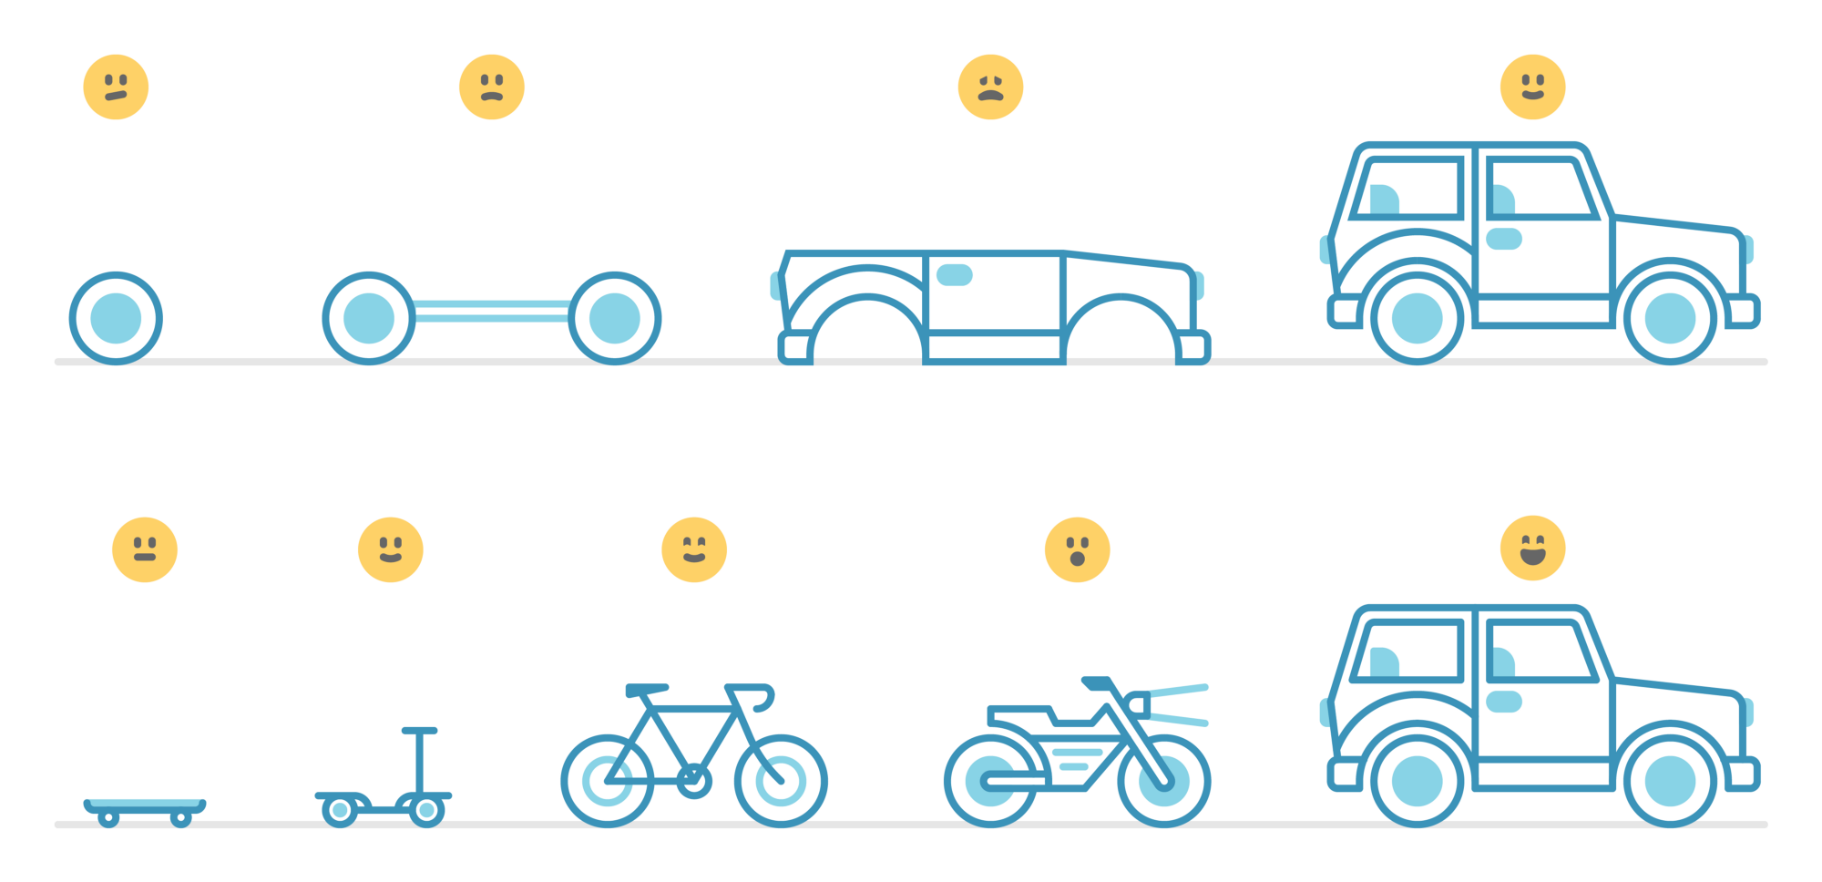
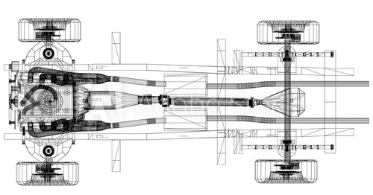
Building a working product with our model
Start with a car
Evolving model
Start with the wheels and chassis
Put the drive shaft and engine
Build the frame and panels
Put in the windows etc.
Make a skateboard
Add a handle
Make a bike, electric bike, motorcycle, go-cart, and eventually a car

Slide 3
Agile methodology
https://medium.com/texidi-your-journey-into-tech/agile-methodology-what-is-that-9afe98033f2

Slide 4
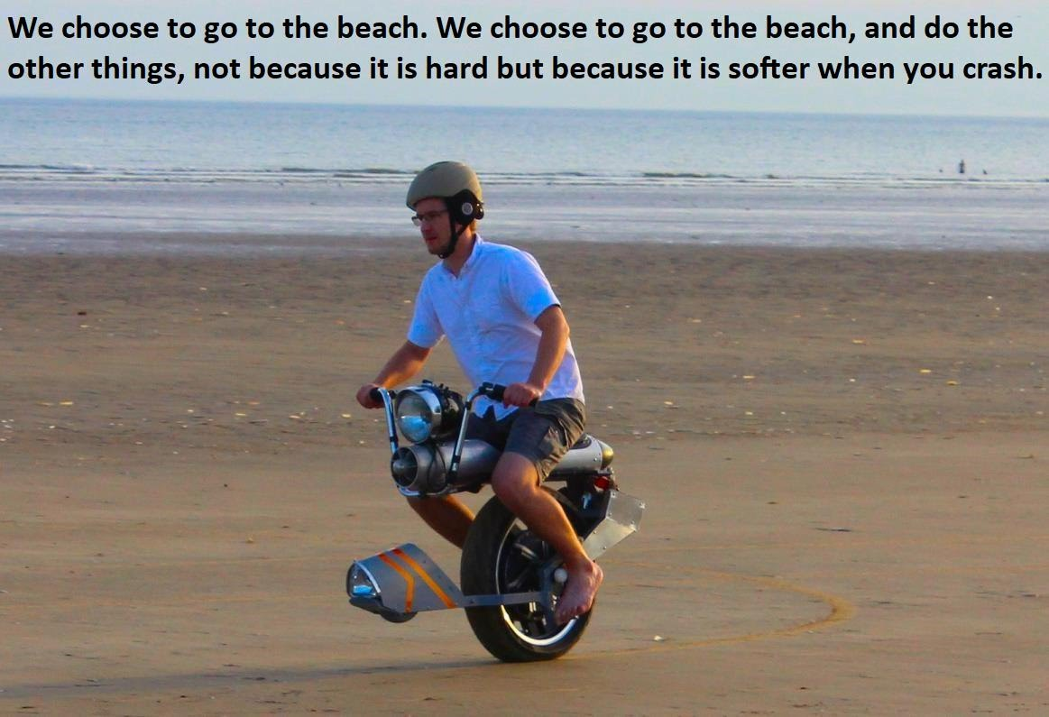
https://sites.google.com/site/onewheeledselfbalancing/

